Slide 1
Comparing Different Models
for Lipreading
DSCI 565 Deep Learning
Hyuntae, Natasha, Isha, Yuko
Group 5

Slide 2
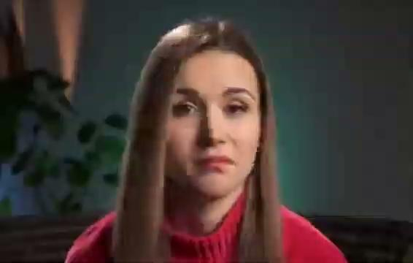
What is Lipreading?
Interpret words by only observing the movements of a speaker’s lips, face, and/or tongue.
Usually, a professional lipreader would watch a speaker (without audio) to decipher the words.
“That sounds fabulous! I will make it a point to go there next time I’m home.”
Lipread
Notes:
Yuko

Slide 3
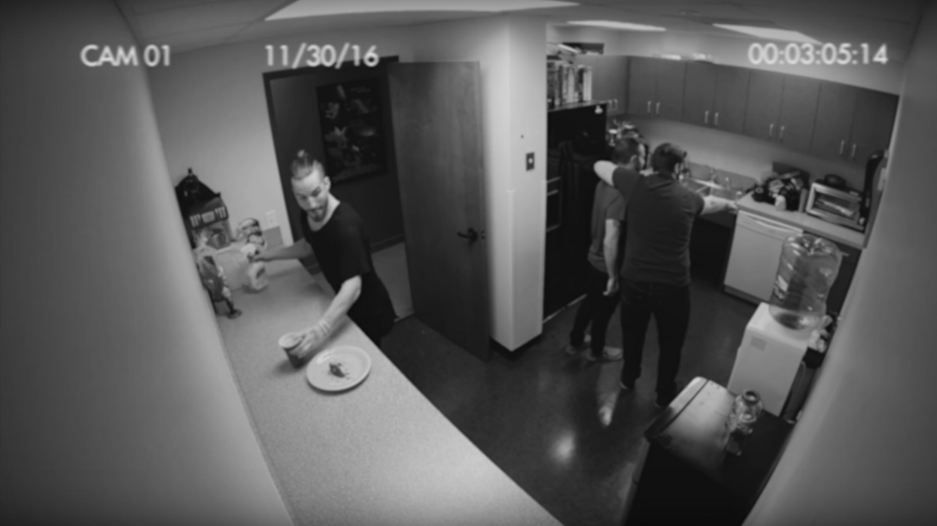
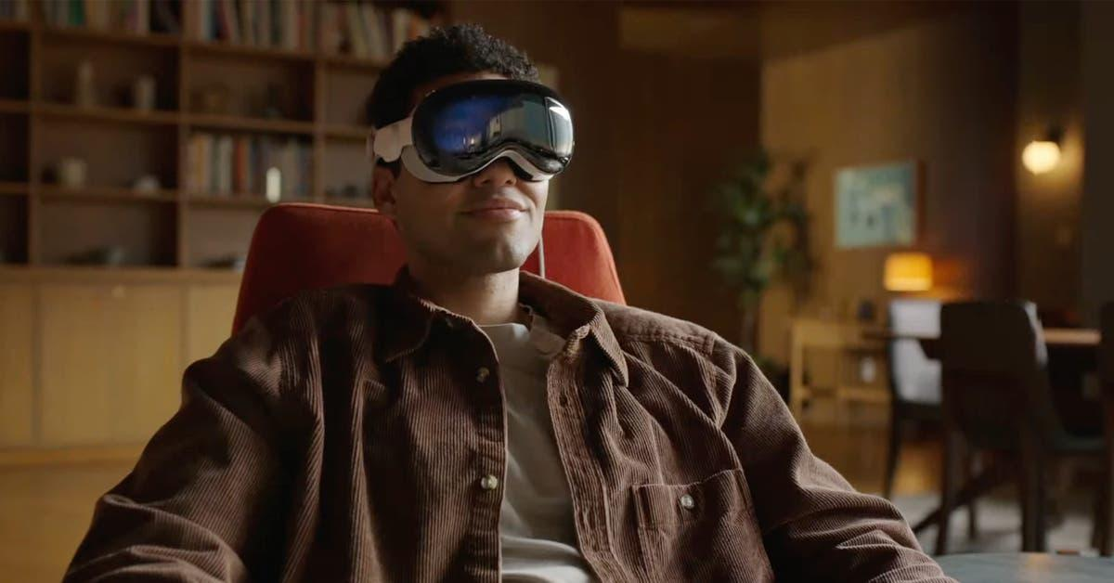
Why Lipread?
Forensic Application
Video evidence from security footages (no audio)
Dashcam video during a car accident (audio may be unclear)
Communication Aid
Incorporate into headsets (i.e. Apple Vision Pros, Meta Glasses, etc)
Automatic real time captions
Advance Speech Recognition Research
Improve voice recognition in noisy environments
Great addition to multimodal models

Slide 4
Original Paper: Lipreading with LSTM (Wand et al.)
Objective: Demonstrate how lipreading can be feasible using temporal-based neural network architecture, LSTM, compared to previous papers that used SVM.
Data: GRID audiovisual corpus
Videos of 19 speakers, each saying 1000 sentences (28 hours)
Each sentence has a fixed structure:
Total of 51 distinct words
sentence
command
(4)
color
(4)
preposition
(4)
letter
(25)
digit
(10)
adverb
(4)
Example:
place
red
at
J
2
please
Notes:
Hyun
Wand, Michael & Koutnik, Jan & Schmidhuber, Jurgen. (2016). Lipreading with long short-term memory. 6115-6119. 10.1109/ICASSP.2016.7472852.
In a seminal study by Wand et al. (2016), the researchers improved upon traditional SVM-based lipreading models by experimenting with a more advanced Long Short-Term Memory (LSTM) network. Their model was designed to predict individual spoken words from video footage by processing only the visual information—specifically, the speaker's mouth movements. To train their model, they cropped the mouth region from the video and used that as input data, bypassing the need for audio entirely. For their dataset, they utilized the GRID corpus (https://spandh.dcs.shef.ac.uk//gridcorpus/), a large, high-quality collection of audiovisual recordings. This dataset consists of recordings from 19 speakers, each delivering 1,000 sentences, containing a vocabulary of 51 unique words. In total, they employed 28 hours of video footage, with a resolution of 360x288 pixels at 25 frames per second, providing an ample amount of aligned video and audio data for training
While Wand et al. (2016) made significant strides by successfully predicting individual words, our project aims to advance this work by focusing on the prediction of entire sentences rather than isolated words. To achieve this, we will implement and evaluate Bi-directional LSTM (Bi-LSTM) and Bi-directional Gated Recurrent Unit (Bi-GRU) models, which are capable of capturing temporal dependencies in both forward and backward directions, thereby improving the model's ability to understand word sequences.

Slide 5
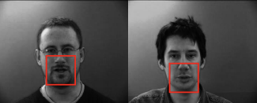

Original Paper: Lipreading with LSTM (Wand et al.)
Sentences have a fixed length of 3 seconds, with frame rate of 25 fps (therefore 75 frames total)
Video has 360 x 288 pixels resolution, greyscale
Local 40 x 40 pixel window was determined
Training and Evaluation was conducted per speaker
Notes:
Hyun
Wand, Michael & Koutnik, Jan & Schmidhuber, Jurgen. (2016). Lipreading with long short-term memory. 6115-6119. 10.1109/ICASSP.2016.7472852.
In a seminal study by Wand et al. (2016), the researchers improved upon traditional SVM-based lipreading models by experimenting with a more advanced Long Short-Term Memory (LSTM) network. Their model was designed to predict individual spoken words from video footage by processing only the visual information—specifically, the speaker's mouth movements. To train their model, they cropped the mouth region from the video and used that as input data, bypassing the need for audio entirely. For their dataset, they utilized the GRID corpus (https://spandh.dcs.shef.ac.uk//gridcorpus/), a large, high-quality collection of audiovisual recordings. This dataset consists of recordings from 19 speakers, each delivering 1,000 sentences, containing a vocabulary of 51 unique words. In total, they employed 28 hours of video footage, with a resolution of 360x288 pixels at 25 frames per second, providing an ample amount of aligned video and audio data for training
While Wand et al. (2016) made significant strides by successfully predicting individual words, our project aims to advance this work by focusing on the prediction of entire sentences rather than isolated words. To achieve this, we will implement and evaluate Bi-directional LSTM (Bi-LSTM) and Bi-directional Gated Recurrent Unit (Bi-GRU) models, which are capable of capturing temporal dependencies in both forward and backward directions, thereby improving the model's ability to understand word sequences.

Slide 6
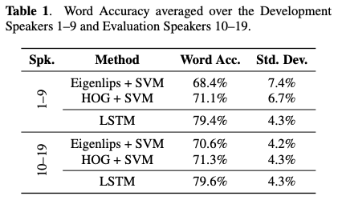
Original Paper: Results
Notes:
Hyun
After thoroughly exploring multiple lipsyncing datasets, we have landed on using the GRID corpus dataset. GRID corpus is a large multi-talker audiovisual sentence corpus to support studies in speech recognition. This dataset consists of 28 hours of high-quality audio and video recordings. There are 19 speakers, male and female, where each speaker says 1,000 sentences. Therefore, there are 19,000 sentences total for there are a total of 51 unique words spoken. Each video recording has a unique sentence structure, but all sentences can only consist of these 51 words. This consistency in the vocabulary allows us to train our neural network model effectively across speakers. The resolution is 360x288 pixels, the color channel is RGB, and the frame rate is 25 frames per second

Slide 7
A Lip Reading Method Based on 3D Convolutional Vision Transformer. Wang et al.
Dataset:
LRW. 500 words from BBC programs with over 1,000 speakers and 550 million clips (one word per clip)
Contributions:
Introduced 3D convolution to vision transformers for lip reading.
Added SE structures for enhanced feature extraction.
Accuracy:
88.5%
Notes:
Natasha The paper prof told us to look at
Components:
Front-End: 3DCvT (Feature Extraction):
3D CNN:
Captures spatiotemporal information across video frames.
Processes input video frames (88 × 88 pixels) with 3D convolution kernels (size: 5×7×75 \times 7 \times 75×7×7, stride: 1×2×21 \times 2 \times 21×2×2).
Transformer Block:
Uses self-attention to capture global feature representations.
Incorporates a SE-Conv-Embedding layer:
Introduces Squeeze-and-Excitation (SE) modules to emphasize relevant feature channels.
Adjusts feature map weights based on channel importance.
Reduces token sequence length while maintaining rich representations using multi-head self-attention and a convolution projection layer.
Back-End: BiGRU (Sequence Modeling):
A bidirectional GRU with three layers.
Input size: 513 (expanded by adding a "word boundary" feature).
Hidden layer size: 1,024.
Output dimension: 2,048, followed by a fully connected (FC) layer for classification.
Classification:
The output of the BiGRU is fed into a fully connected layer for the final classification of lip movements.
Accuracy of 88.5% on LRW.
Accuracy of 57.5% on LRW-1000.

Slide 8
A Lip Reading Method Based on 3D Convolutional Vision Transformer. Wang et al.
Components:
Front-End: 3DCvT (Feature Extraction):
3D CNN:
Captures spatiotemporal information across video frames.
Processes input video frames with 3D convolution kernels.
Transformer Block:
Uses self-attention to capture global feature representations.
Incorporates a SE-Conv-Embedding layer:
Introduces Squeeze-and-Excitation to emphasize relevant feature channels.
Adjusts feature map weights based on channel importance.
Reduces token sequence length while maintaining rich representations
Back-End: BiGRU (Sequence Modeling):
A bidirectional GRU with three layers.
Input size: 513 (expanded by adding a "word boundary" feature).
Hidden layer size: 1,024.
Output dimension: 2,048, followed by a fully connected (FC) layer for classification
Notes:
Natasha The paper prof told us to look at
Components:
Front-End: 3DCvT (Feature Extraction):
3D CNN:
Captures spatiotemporal information across video frames.
Processes input video frames (88 × 88 pixels) with 3D convolution kernels (size: 5×7×75 \times 7 \times 75×7×7, stride: 1×2×21 \times 2 \times 21×2×2).
Transformer Block:
Uses self-attention to capture global feature representations.
Incorporates a SE-Conv-Embedding layer:
Introduces Squeeze-and-Excitation (SE) modules to emphasize relevant feature channels.
Adjusts feature map weights based on channel importance.
Reduces token sequence length while maintaining rich representations using multi-head self-attention and a convolution projection layer.
Back-End: BiGRU (Sequence Modeling):
A bidirectional GRU with three layers.
Input size: 513 (expanded by adding a "word boundary" feature).
Hidden layer size: 1,024.
Output dimension: 2,048, followed by a fully connected (FC) layer for classification.
Classification:
The output of the BiGRU is fed into a fully connected layer for the final classification of lip movements.
Accuracy of 88.5% on LRW.
Accuracy of 57.5% on LRW-1000.

Slide 9
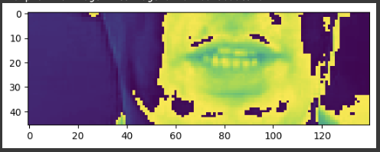
Our experimental setup
Dataset:
Data from a single speaker used for training (1000 videos)
Videos used along with their corresponding annotations
Training Configuration
Optimizer: Adam optimizer with a learning rate of 0.0001.
Loss Function: Custom CTCLoss for sequence modeling.
Epochs: Set to 100 for training.
Notes:
We follow a similar preprocessing approach as described in the first paper.The load_video() function reads video frames using OpenCV, Converts to grayscale, extracts a specific region of interest (mouth region) by hardcoding coordinates (frame[190:236, 80:220, :]) as all videos have the same layout., and normalizes them for consistent input.
The load_alignments() function extracts tokens from alignment files while ignoring silence and converts them to numerical representations.
. Dense Output Layer
Fully Connected Layer: Outputs class probabilities using a softmax activation function.
Why Use CTC Loss for Lipreading?
Connectionist Temporal Classification (CTC) loss is particularly suitable for lipreading tasks due to the following reasons:
Alignment-Free Training: CTC does not require pre-aligned labels, allowing the model to learn the mapping between input video sequences and output text sequences without explicit frame-level alignment.
Variable-Length Sequences: Lipreading often involves variable-length input and output sequences (e.g., different word or sentence lengths). CTC dynamically handles these variations during training and decoding.
Handling Silent Frames: Lipreading datasets often contain frames with no speech-related visual activity (e.g., pauses or silence). CTC can naturally skip these frames, focusing only on meaningful inputs.
End-to-End Optimization: CTC integrates sequence alignment and prediction into a single loss function, streamlining the training process for sequence-to-sequence tasks.
We tried 5 model architectures, namely the original LSTM model from thefirst paper, LSTM w convolution layers as seen in the second paper along with, GRU and Bi-GRU.
Example:
For a lipreading model, if the input is a video sequence of mouth movements and the target output is a transcription of spoken words, CTC loss can help the model learn to output the correct sequence of characters without needing to align each frame of the video to each character.
How it Works:
The model produces a probability distribution for each time step, indicating the likelihood of each possible output (including the blank token).
CTC calculates the total probability of all valid output sequences that could be generated from the input sequence by summing the probabilities of all alignments that yield the same output.
The loss function is then the negative log probability of the correct output sequence, encouraging the model to learn better alignments over time.
CTC loss is widely used in deep learning architectures involving RNNs, LSTMs, GRUs, and other sequence models where the input-output alignment is not predetermined.

Slide 10
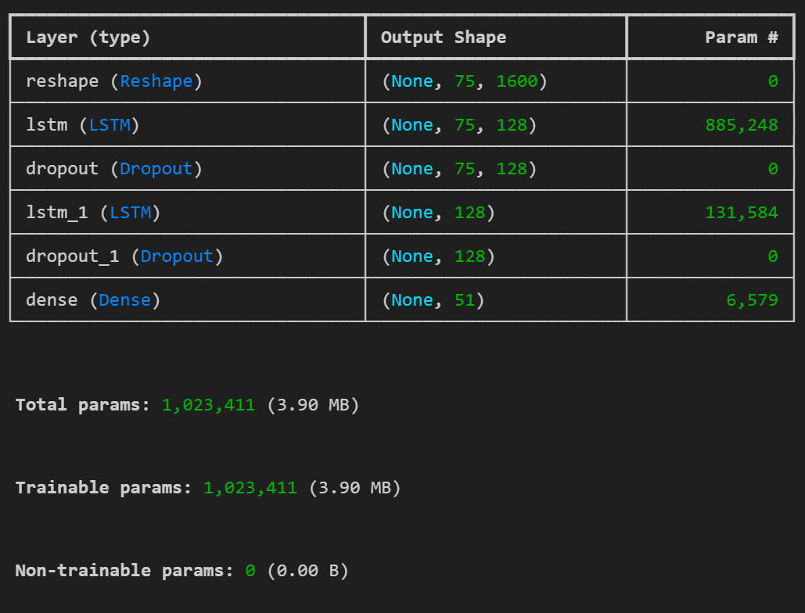
Original paper - LSTM model (Natasha)
Reshape layer Reshapes the input data (frames) into a 2D format (time_steps, features)
First LSTM Layer
Dropout Layer
Second LSTM Layer
Dropout Layer
Dense Layer
This model doesn’t capture spatial information!

Slide 11
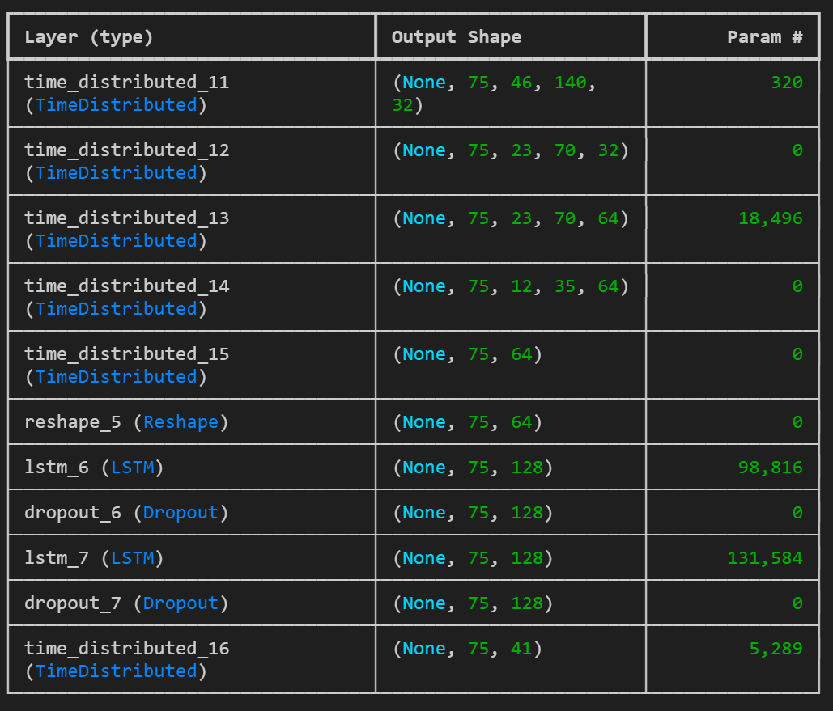
LSTM and convolutional layers
Time Distributed Convolutional Layers
These layers apply 2D convolutions and max-pooling independently to each video frame.
Global Feature Summarization (GlobalAveragePooling2D)
summarizes spatial features across each frame
Reshape for LSTM input
Dropout Layers
TimeDistributed Dense Layer

Slide 12
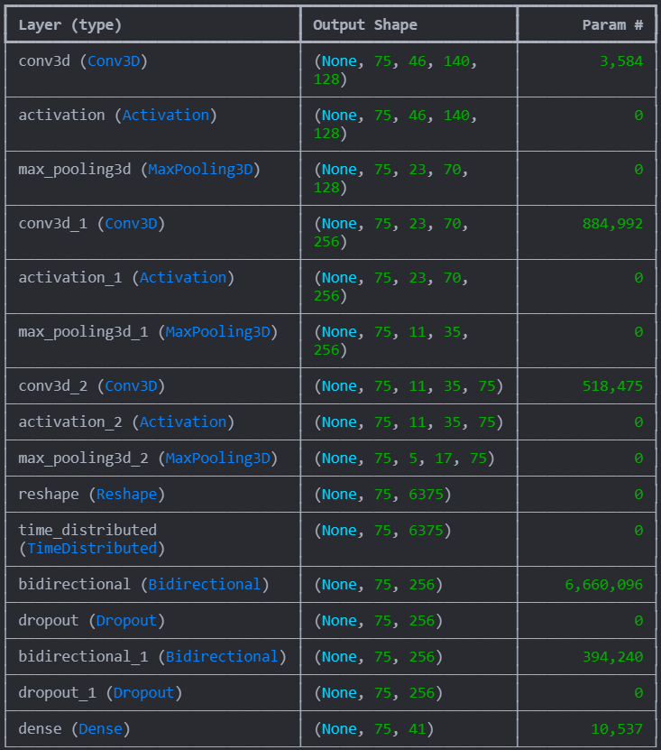
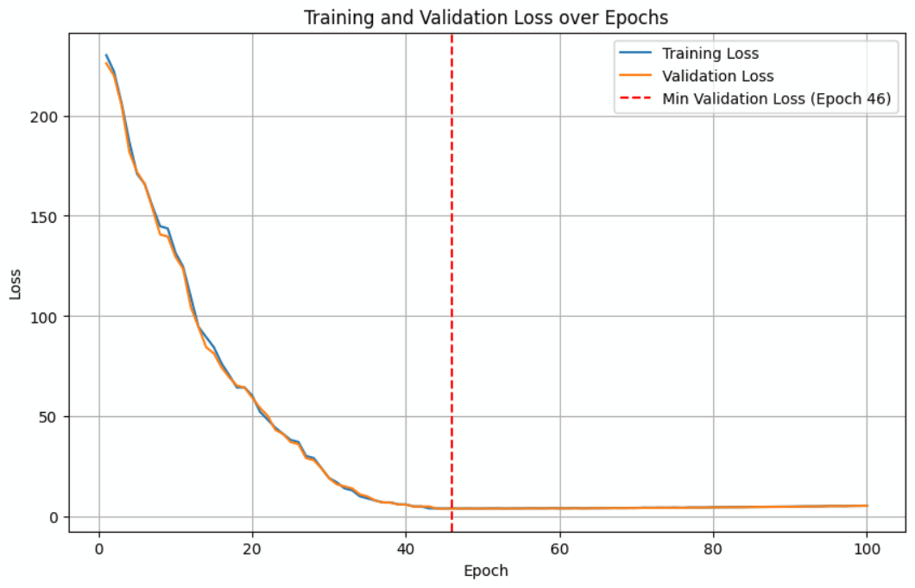
Bi-lstm (Hyun)
Notes:
[rundown]
1)Bi-LSTM:
Out of 100 Epoch, 44th epoch turned out to have the lowest validation lowest.
- Trainable params: 8.4M
1.1)Three sets of...
> Conv3D(128, 3, input_shape=(75,46,140,1), padding='same')
- num_of_filters = 128
- padding='same'; ensures output spatial dimensions remian the same as input.
> Acitvation('relu')
> MaxPool3D((1,2,2))
- reduce spatial resolution (46x140 to 23x70) by keeping the temporal dimension (75) intact.
#------------------------------------------------------
1.2)Reshaping & Time-distributed flattening
> tf.keras.layers.Reshape(75,-1)
- flatten spatial dimension into a single vector for each frame.
> TimeDistributed(Flatten): ensures that each time step is flattened independently.
#------------------------------------------------------
★1.3) Two sets of Bidirectional LSTM
Bi-LSTM model is to process 'temporal' dependencies,i.e., patterns across frames, in both forward and backward directions.
> LSTM units are more powerful than other models, such as GRUs, in capturing 'long-range' dependencies but are computationally more expensive.
> Dropout 50% layer to prevent overfitting.
#------------------------------------------------------
1.4) Output Layer: Dense layer
> Dense(char_to_num.vocabulary_size()+1, 'he_normal', 'softmax')
- vocabulary_size()+1 accounts for all target classes and extra "blanks" class, typically required for CTC loss in seq-to-seq tasks.
- 'softmax' converts <Logit> into <probabilities>

Slide 13
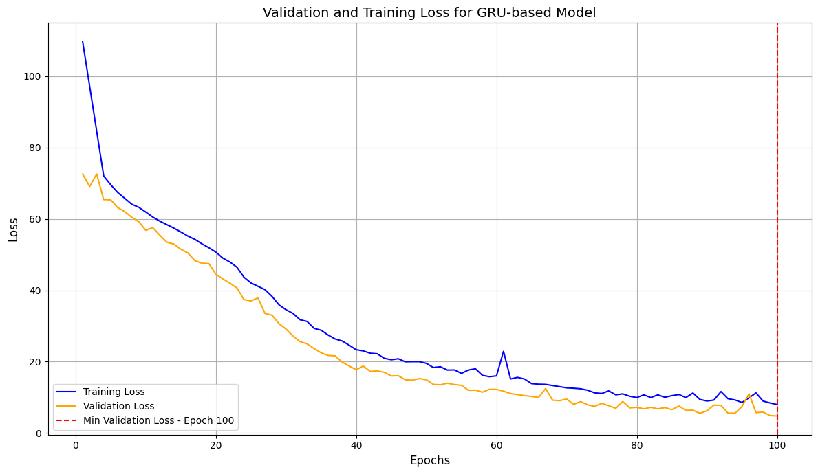
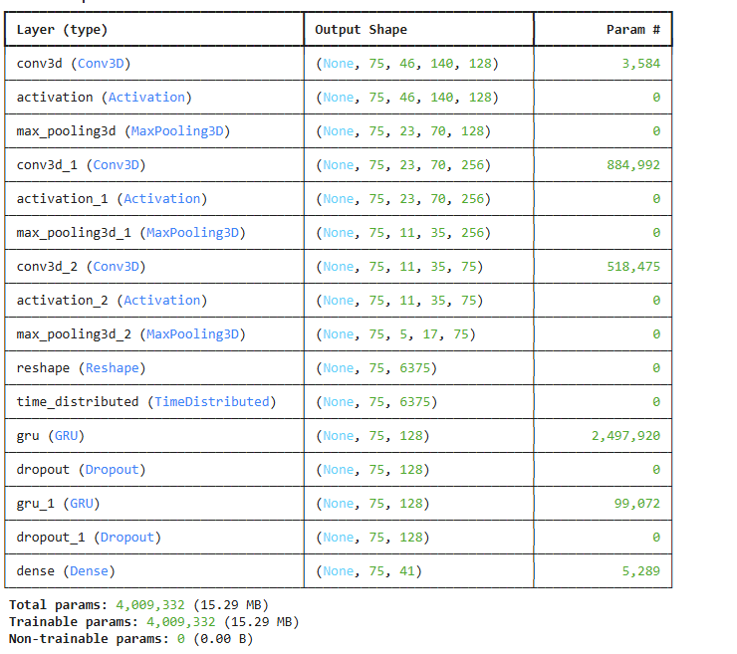
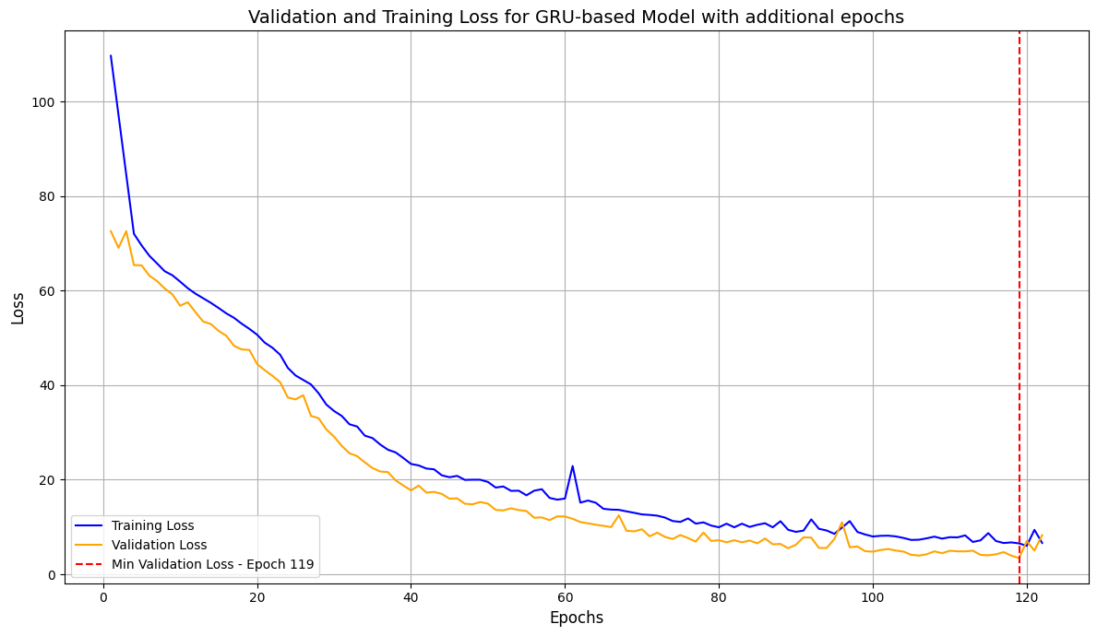
GRU (Isha)
Notes:
The GRU based models is the simplest model we tried with the smallest set of parameters. However, the validation loss achieved was comparable to Bi-GRUbut took a larger number of epochs to achieve. As evident from the graph of validation and training loss. We see that the lowest val loss was acheived at 100 epochs suggesting the model may improve if run for more epochs. To test this theory we trained for additional epochs untils we noticed an increase in validation loss. The graph for the same is shown below where the minimum val loss was 3.42.

Slide 14
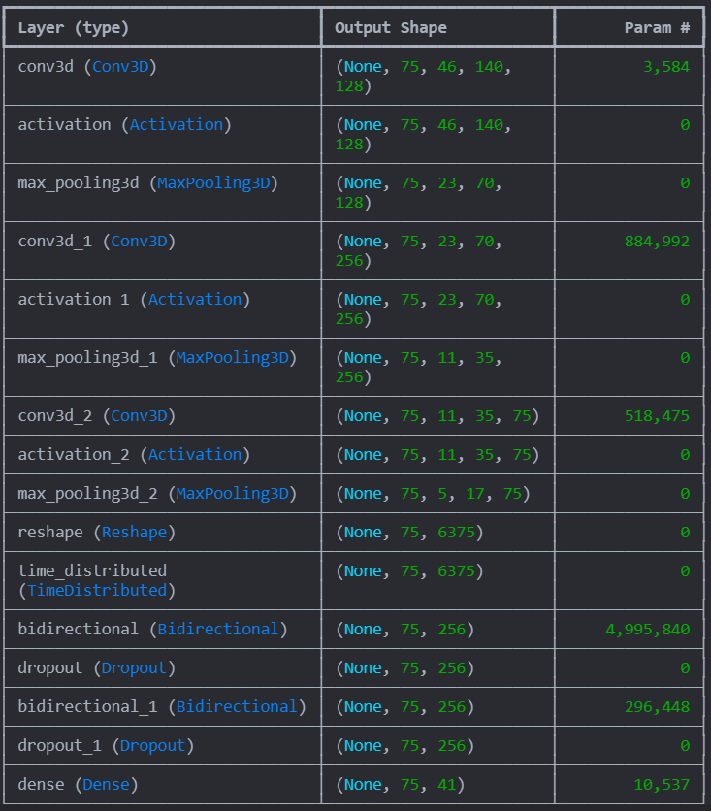
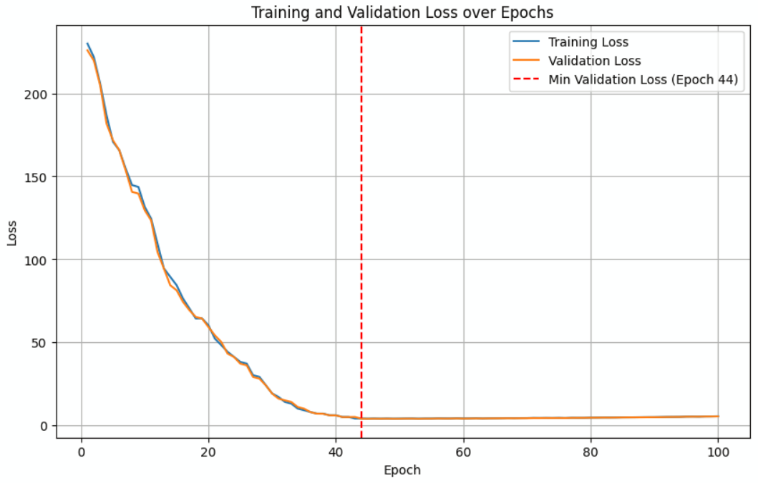
Bi-GRU (Hyun)
Notes:
2)Bi-GRU:
[Rundown] Out of 100 Epoch, 46th epoch turned out to have the lowest validation lowest.
- Trainable params: 6.7M
2.1)Three sets of...
> Conv3D(128, 3, input_shape=(75,46,140,1), padding='same')
- num_of_filters = 128
- padding='same'; ensures output spatial dimensions remian the same as input.
> Acitvation('relu')
> MaxPool3D((1,2,2))
- reduce spatial resolution (46x140 to 23x70) by keeping the temporal dimension (75) intact.
#------------------------------------------------------
2.2)Reshaping & Time-distributed flattening
>tf.keras.layers.Reshape(75,-1)
- flatten spatial dimension into a single vector for each frame.
- TimeDistributed(Flatten): ensures that each time step is flattened independently.
#------------------------------------------------------
2.3) Two sets of...
Bidirectional GRU
Bi-GRU layers capture temporal dependencies in both forward and backward directions.
> GRU is a lightweight recurrent unit compared to LSTMs, suitable for sequential data.
> Dropout 0.5 randomly dropping 50% of nodes.
#-------------------------------------------------------
2.4) Dense Layer
> Dense(char_to_num.vocabulary_size()+1, 'he_normal', 'softmax')
- Dense layer outputs predictions for each time step
- Vocabulary size +1: Accounts for all characters plus a blank label (for tasks like CTC-based text recognition).
- Softmax converts <Logits> into <Probabilities>

Slide 15
Key accomplishments and contributions
 | LSTM as in Wand et. al | GRU | Bi-GRU | LSTM with convolutional layers | Bi-LSTM
Validation loss | 49.191 | 4.785 | 4.098 | 24.378 | 2.927
Epoch | 53 | 100 | 44 | 79 | 46
The table above illustrates the lowest validation loss for each of the 4 models over 100 epochs and also the corresponding epoch
Notes:
In addition to the LSTM model used in the paper, we tried LSTM w convolution layers, GRU and Bi-GRU
The table above illustrates the lowest validation loss for each of the 4 models over 100 epochs and also the corresponding epoch. We observe Bi-LSTM performs the best having a validation loss of 2.927. We hypothesize that this could be due to Bi-LSTM providing a more comprehensive view by considering both past and future sequences, which is crucial for understanding lip movements and predicting speech accurately.
LSTM's architecture with separate input, forget, and output gates allows it to model long-term dependencies and learn more detailed representations than simpler architectures like GRU. We believe the performance of LSTM may be improved by using Conv3D instead of Conv 2D to capture spatiotemporal features directly and we will do this in final report

Slide 16
Prediction Results
Real Text: ‘bin red at S nine again’
Model | Loss | Prediction
LSTM | 49.191 | “la re t ne an”
LSTM with Conv2D | 24.378 | “bin wre at he again”
GRU | 4.785 | “bin red at nine again”
Bi-LSTM | 2.927 | “bin red at nine again”
Bi-GRU | 4.098 | “bin red at nine again”
Notes:
Prediction result
the real text was 'bin red at S nine again'.
Highest loss ; LSTM model with 49.1
Lowest loss ; Bi-LSTM 2.9
'S' is missing -> Because it's single word, hard to predict for the models even have low-level loss around 3.

Slide 17
Issues encountered and deviations from the original plan
Deviations from Original Plan:
Expanded Model Selection:
Added More Architectures: Included additional models such as GRU and LSTM with Convolutional Layers to extend the model comparison beyond just Bi-LSTM and Bi-GRU as originally planned.
Data Constraints:
No New Data Acquisition: The project did not include the gathering or integration of additional datasets beyond what was initially available.
Challenges Encountered:
Resource Limitations on Colab:
Runtime Constraints: Training on Google Colab was impacted by limited computational resources and session timeouts.
Checkpointing: To manage training interruptions, checkpoints were implemented, allowing training to pause and resume without starting over.
Notes:
Isha
During the course of the project, there were a few notable deviations from our original plan. Initially, we had planned to use only Bi-LSTM and Bi-GRU models for our lipreading task. However, to enhance our model comparison and assess different architectures, we expanded our scope to include GRU and LSTM models with convolutional layers as well.
One constraint we faced was that we did not have the opportunity to acquire additional data. We worked with the initial dataset provided without any new data integrations.
Training on Google Colab brought its own challenges due to runtime limitations and session timeouts. To address this, we incorporated checkpointing to save training progress and resume from where we left off without losing work. This approach helped us manage the training process within the constraints of Colab's environment. These steps were essential to ensure we could complete the training efficiently and meet our project goals

Slide 18
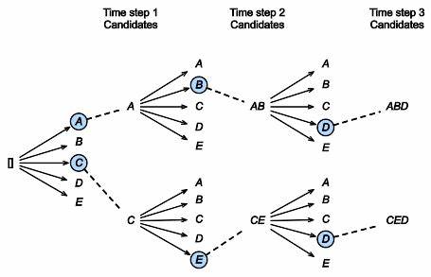
Conclusion and future plans
Conclusion:
The model performs effectively on the current dataset with a 51-word vocabulary.
Performance is promising despite dataset limitations and short sequence structures.
Future Work:
Data and Model Enhancements:
Expand the corpus to include longer sequences and more words.
Explore weight initialization variations to improve speed and accuracy.
Advanced Models:
Implement transformers and beam search for better sequence prediction.
Dynamic Extraction:
Integrate computer vision for dynamic mouth tracking to generalize model application.
Notes:
Isha
Our model demonstrated effective performance on the current lipreading dataset, which features a limited 51-word vocabulary and short sequences. Despite the simplicity of the dataset, the results indicate strong potential for such an approach in practical applications.
However, our current approach has room for growth, especially in addressing real-world constraints not present in the existing dataset.
Future improvements could include expanding the vocabulary and working with longer sequences to create more comprehensive training datasets. Experimenting with different weight initializations might also enhance training speed and model accuracy. Leveraging transformer models could provide significant benefits, as they excel at capturing complex relationships within sequences and handling long-term dependencies better than traditional RNNs. Additionally, incorporating beam search during the decoding process would improve word prediction accuracy by evaluating multiple potential sequences and selecting the most probable output. Beam Search is a search algorithm commonly used in sequence generation tasks, such as machine translation, speech recognition, and lipreading. It helps find the most likely output sequence by expanding the most promising nodes in a search space.
Key Concepts:
Greedy Search: A simpler approach that picks the single best option at each step, which can lead to suboptimal results because it doesn't consider multiple potential paths.
Beam Search: Improves on greedy search by keeping track of a fixed number of top paths (called "beam width") at each step.
Lastly, integrating computer vision techniques to extract mouth movements dynamically would make the model more adaptable to varied data types and real-world scenarios. These enhancements could position the model for more robust and practical use beyond controlled environments.

Slide 19
Thank you!
Questions?

